Slide 1
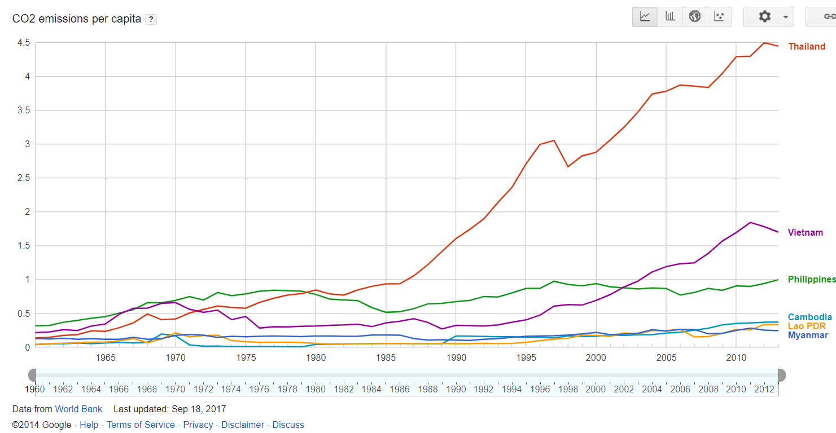
#SaveMekong
Predicting the future of our air quality

Slide 2
PROBLEM
Rising Air Pollution & Health Issues
Notes:
Air pollution is a major environmental risk to health. High air pollution levels have contributed to diseases of the heart and lungs. In 2014, 92% of the world population was living in places where the WHO air quality guidelines levels were not met.
Poor air quality is especially prevalent in developing countries like those in lower delta Mekong. They have inefficient modes of transport and inefficient combustion of household fuels for cooking. Coupled with limited access to healthcare, health conditions of Mekong citizens exacerbate.

Slide 3
AIM - Early Warning System
Create a visualisation and prediction model to monitor air quality in Mekong countries.
Allow stakeholders to contribute suggestions to lower emission levels.
Communication channel for fast roll out of measures whenever necessary

Slide 4
Open Data
Platforms
World Bank CO2 emission (1960-2014)
https://data.worldbank.org/indicator/EN.ATM.CO2E.KT
WebApp: HTML, CSS, JavaScript, PHP
Analytics: R, Tableau

Slide 5
DEMONSTRATION
Let’s start proceed with the demonstration of our web-app
Notes:
Using past carbon emission data, predictions are generated using a double exponential smoothing model. This data can then serve as a warning when countries are exceeding their emission thresholds.
Target audience: Leaders of various sectors
When a certain solution is selected, a pre written mail is then sent to relevant authorities informing them on the immediate measures implemented allowing them to take action
Relevant authorities from different sectors will discuss eventually coming up with appropriate ideas
The solutions which these people provide will consider their relevant sectors while solving the environmental problem at hand

Slide 6
INTO THE FUTURE - Scaling and Improvements
Improve datasets and working with governmental bodies to harvest more data
Upgrade of predictive algorithm with better datasets and more advanced algorithms
Integration with governmental agencies that allows immediate implementation of regulation measures
Serves as a communication channel, notifying various stakeholders of the measures

